Slide 1
Power System Restructuring
Courtesy of:
Dr Kashif Imran, NUST, Islamabad

Slide 2
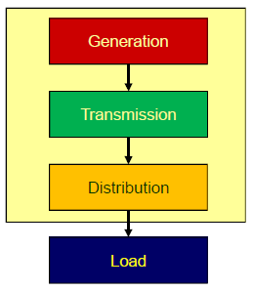
How Power System is Organized?
Vertically Integrated Utility
Consumers had no choice but to buy from a local utility
The utility owned generation and transmission
Sometimes distribution too
It was responsible for
Overall operation
Security of supply
Planning of new generation capacity and transmission

Slide 3
Why Competition?
What do we mean by competition?
Giving customers a choice of where to buy and at what price
Letting generators compete to sell their energy by offering it at a competitive price
Why competition?
To improve efficiency
Monopolies could be inefficient - high electricity prices
Encourage new technologies
New opportunities for investment

Slide 4
Electricity as a Commodity
What is a commodity?
Is electricity the same as other commodities?
Needs to instantaneously meet demand and supply
No means to effectively store energy
Transmission being a natural monopoly
Severe limitations in the ability to control the flow of electricity

Slide 5
Some Important Issues
Electricity is not the same as other commodities
Effects of the Kirchhoff’s Law
Effects of location and network capacity
Effects of demand variation
Effects of uncertainty and security of supply

Slide 6
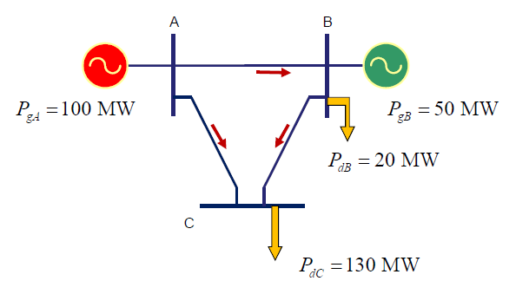
Kirchhoff’s Law, Location and Transmission Capacity

Slide 7
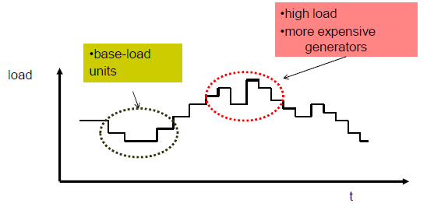
Demand Variation
Load is not constant at all times
Its shows daily, weekly and seasonal variations

Slide 8
Issue of Uncertainty
Why is it important to correctly forecast load demand and generation availability
Instantaneous match between load and generation
Intermittent nature of wind and solar
Limited means to store energy
How do we cover the mismatch
Surplus generation – load following
Excessive load – load shedding
What about unpredictable imbalances like generation and line outages
Security of supply becomes a concern
Reserve generation becomes a necessity

Slide 9
Structural Changes
Corporatization
Public owned organizations behave like investor owned company (not responsible for employment creation)
Unbundling (Vertical de-integration)
Separation of transmission from generation and distribution
Fragmentation (Horizontal de-integration)
Partitioning of generation and distribution sectors to increase market participants

Slide 10
Structural Changes (2)
Competition
Traditional links between customers and utilities are removed
Generators compete to sell at the market
Customers can choose where and from whom to buy
Privatization
Government owned companies are sold to private investors, e.g. K-Electric
Generation facilities built by private investors, e.g. Independent Power Producers (IPPs)
New arrangements for transmission lines

Slide 11
Results of Structural Changes
System Operator
National Transmission and Dispatch Company (NTDC) Limited
Market Operator
Central Power Purchasing Agency Guarantee (CPPAG) Limited
Regulator
National Electric Power Regulatory Authority (NEPRA)
Notes:
Open access to Transmission (distribution) network is essential to ensure wholesale (retail) competition

Slide 12
Results of Structural Changes (2)
Generation Companies
Four thermal generation companies (GENCOs)
Numerous independent power plants (IPPs)
Hydro power plants retained by WAPDA
Distribution Companies
Nine regional distribution companies (DISCOs)
Notes:
Open access to Transmission (distribution) network is essential to ensure wholesale (retail) competition

Slide 13
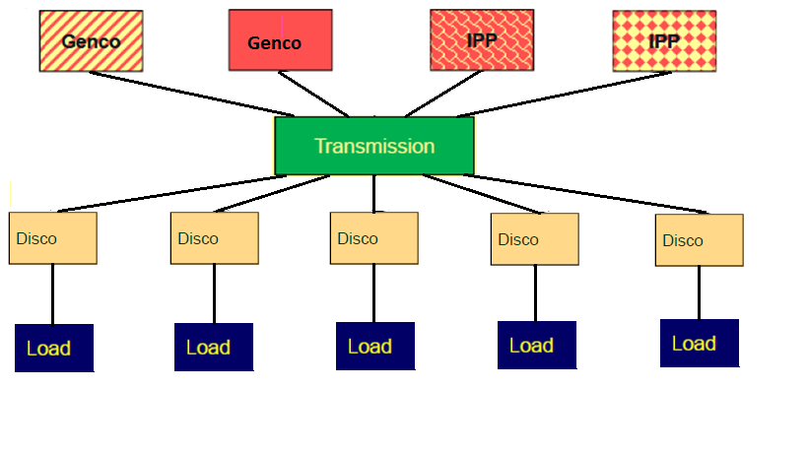
Single Buyer Model
Notes:
Open access to Transmission (distribution) network is essential to ensure wholesale (retail) competition

Slide 14
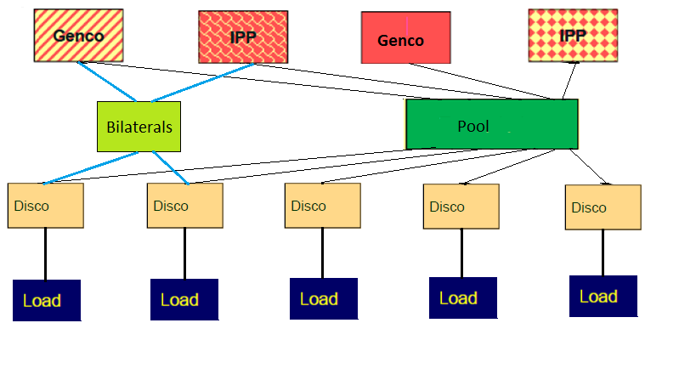
Single Buyer Plus Model
Notes:
Open access to Transmission (distribution) network is essential to ensure wholesale (retail) competition

Slide 15
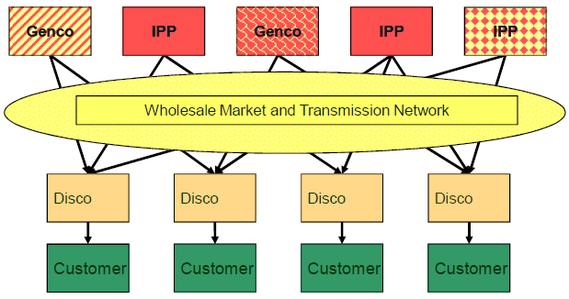
Wholesale Competition Model
Notes:
Open access to Transmission (distribution) network is essential to ensure wholesale (retail) competition
Competition only comes about if generation capacity exceeds load demand

Slide 16
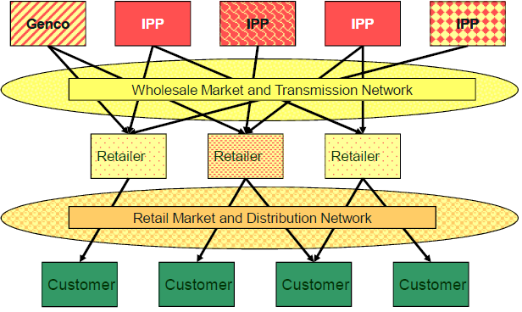
Retail Competition Model
Notes:
Open access to Transmission (distribution) network is essential to ensure wholesale (retail) competition

Slide 17
Generation Side
In Pakistan, mainly consists of GENCOs, IPPs and Hydro that sell electricity to monopoly single buyer NTDC
GENCOs
Owned by government, earmarked for privatization
IPPs
open to private investment with regulated profit
Hold sovereign guarantees for long term power purchase agreements
Energy charges (Rs/kWh), Capacity charges (Rs/kW/hour)
Hydro
Owned by government (WAPDA), not for privatization
Run as least cost base generation subject to irrigation constraints
In competitive environment
GENCOs
Aim to maximize profit by selling electricity and other services
Notes:
This is the first part to be liberalised

Slide 18
Transmission
In Pakistani scenario
National Transmission and Dispatch Company (NTDC) Limited
Planning and operations of transmission network
Reliable and economic power system operation
Central Power Purchasing Agency Guarantee (CPPAG) Limited
Solely responsible for implementing and administering the “Single Buyer Plus” market mechanism.
Currently handling cash flows from distribution to generation
In competitive environment
A public body, called Independent System Operator (ISO), acts as both Transmission Operator and System Operator (North America)
Transmission system operator is publicly owned and power exchange is privately owned (Europe)
Notes:
This is the first part to be liberalised

Slide 19
Distribution Side
In many electricity markets this is still a regulated monopoly (DISCO)
Sells electricity to captive consumers in a designated geographical area
Owns and operates distribution network
In competitive environment
Distribution network operator
Network functions (operations and planning) - still regulated
Supplier
Buys electrical energy on wholesale market
Supplies energy to consumers that are not necessarily connected to the same part of the distribution network
Notes:
This is the last part to be deregulated

Slide 20
Consumers
Large
Often actively participate in market
May buy from wholesale market or by bilateral trading
Small
Has to rely on buying from supplier
May be active participant, using smart meters and responding to real time pricing

Slide 21
Regulator
Government body – defines and approves market models and rules
Sets prices for products and services provided by monopolies
Ensures fair open access to transmission
Addresses problems of inefficiencies
Regulates security requirements and quality of service
Investigates market participants behaviours

Slide 22
Markets
Basic Concepts and Organization
Dr Kashif Imran
Adopted from lecture slides of Dr Ivana Kockar at University of Strathclyde

Slide 23
Markets
What is a market?
A place where buyers and sellers meet to exchange their goods
So buyers and sellers are market participants
It offers opportunity for buyers and sellers to
Compare prices
Estimate demands
Estimate supply
Decide on how much to buy/sell and what price
To investigate how markets function we need to develop models that describe behaviour of market participants
There are different ways to trade and different ways to organize trading

Slide 24
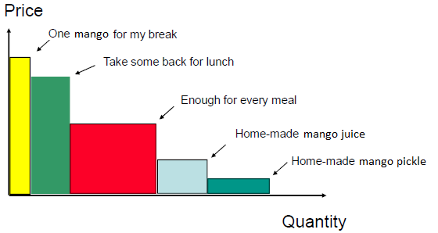
How much do I value Mangoes?

Slide 25
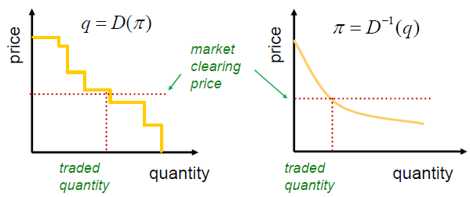
Modelling Consumers
Consumers behaviour is modelled by the demand curve – aggregation of the individual demands of all consumers

Slide 26
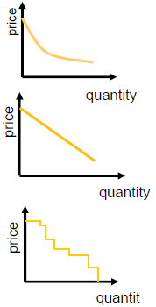
Modelling Consumers
Consumers spend until the price is equal to their marginal utility
What does that mean?
If you produce pickle, you will buy only when a price is sufficiently low so that after selling it you have earned some profit
….. or if it is less expensive than buying pickle at a store ….

Slide 27
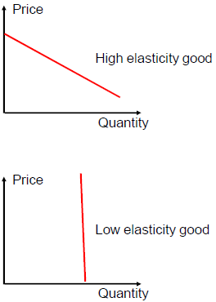
Elasticity of Demand
What is elasticity
Relative change in demand w.r.t. relative change in price
Slope is an indication of the elasticity of demand
High elasticity
Non essential good
Easy substitution
Low elasticity
Essential good
No substitutes
Electrical energy has a very low elasticity in the short term

Slide 28
Supply Side
How many widgets shall I produce
Goal: make a profit on each
Produce one more widget if and only if the cost of producing it is less than the market price
Need to know the cost of producing the next widget
Considers only the variable costs
Like fuel cost
Ignores the fixed costs
Investment in production plants and machines

Slide 29
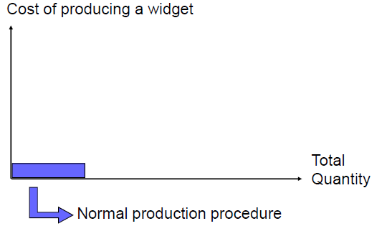
How much does the next one cost?
Notes:
Open access to Transmission (distribution) network is essential to ensure wholesale (retail) competition

Slide 30
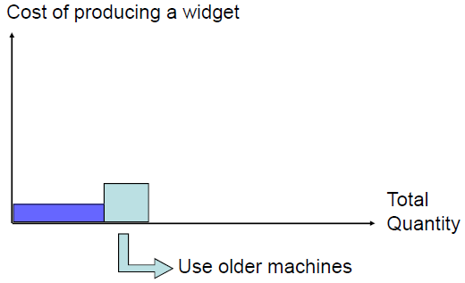
How much does the next one cost?
Notes:
Open access to Transmission (distribution) network is essential to ensure wholesale (retail) competition

Slide 31
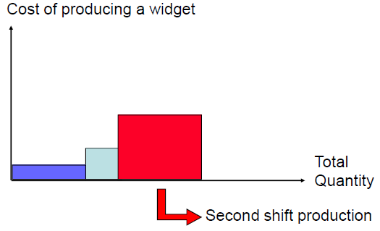
How much does the next one cost?
Notes:
Open access to Transmission (distribution) network is essential to ensure wholesale (retail) competition

Slide 32
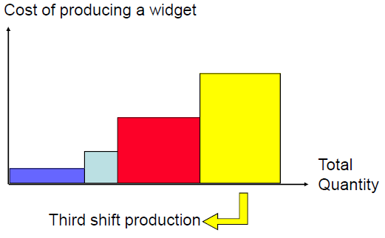
How much does the next one cost?
Notes:
Open access to Transmission (distribution) network is essential to ensure wholesale (retail) competition

Slide 33
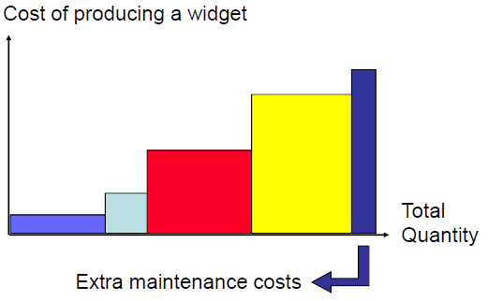
How much does the next one cost?
Notes:
Open access to Transmission (distribution) network is essential to ensure wholesale (retail) competition

Slide 34
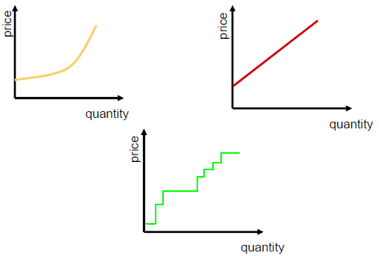
Modelling Suppliers
Supply curve – aggregation of the individual supply curves of all producers
Notes:
Open access to Transmission (distribution) network is essential to ensure wholesale (retail) competition

Slide 35
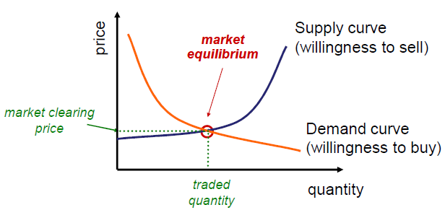
Market equilibrium
The point where supply equals demand
Notes:
Open access to Transmission (distribution) network is essential to ensure wholesale (retail) competition

Slide 36
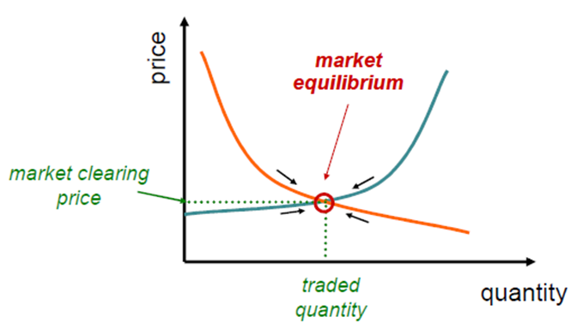
Market equilibrium
Sellers have no incentive to sell for less
Buyers have no incentive to buy for more
Notes:
Open access to Transmission (distribution) network is essential to ensure wholesale (retail) competition

Slide 37
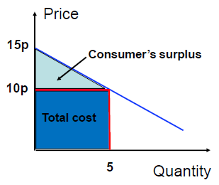
Consumers Surplus
Marginal Pricing Approach
Buy 5 mangoes at 10p
Total cost = 50p
I am getting mangoes at a price lower than I would have been ready to pay
Surplus = 12.5p
Notes:
Open access to Transmission (distribution) network is essential to ensure wholesale (retail) competition

Slide 38
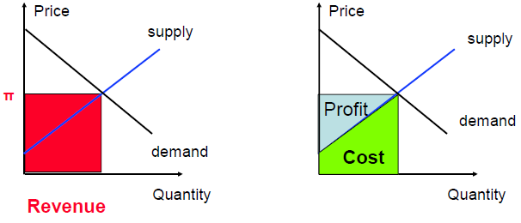
Economic Profit of Suppliers
Cost includes only the variable cost of production
Economic profit covers both fixed costs and shareholders returns
Notes:
Open access to Transmission (distribution) network is essential to ensure wholesale (retail) competition

Slide 39
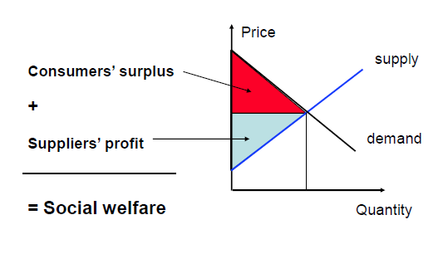
Social or Global welfare
Notes:
Open access to Transmission (distribution) network is essential to ensure wholesale (retail) competition

Slide 40
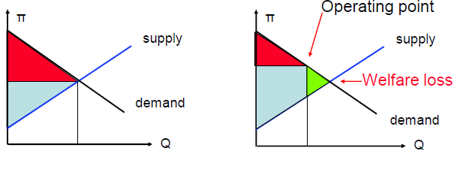
Market Equilibrium and Social Welfare
Market Equilibrium
Artificially high price:
Larger supplier profit
Lower consumer surplus
Smaller social welfare
Notes:
Open access to Transmission (distribution) network is essential to ensure wholesale (retail) competition

Slide 41
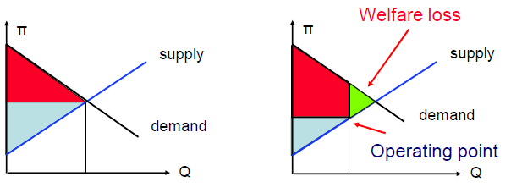
Market Equilibrium and Social Welfare
Market Equilibrium
Artificially low price:
Lower supplier profit
Larger consumer surplus
Smaller social welfare
Notes:
Open access to Transmission (distribution) network is essential to ensure wholesale (retail) competition

Slide 42
Back to our main assumptions …..
In much of economics we use a framework built on the following two principles
The optimization principle – people try to choose the best patterns of consumption that they can afford; social welfare optimization
The equilibrium principle – prices adjust until the amount that people demand of something is equal to the amount that is supplied

Slide 43
Perfectly Competitive Market
In a perfectly competitive market
Each supplier and consumer is sufficiently small so that it cannot affect market price
Basically, they are all price takers

Slide 44
Imperfect Market
Market Power
Some market participants can affect price
Modelled by
Cournot model
Firms decide on how much quantity they produce
Bertrand model
Firms decide the price at which they sell their produce
Monopoly
Not enough market participants on one side

Slide 45

Market Structure
Monopoly
Monopolist sets the price at will
Must be regulated
Perfect competition
No participant is large enough to affect the price
All participants act as ‘price takers’
Oligopoly
Some participants are large enough to affect the price
Strategic bidders have market power
Others are price takers

Slide 46
Organization of Markets
Depending on when trades are arranged:
Arranged some time before they actually take place
Direct bilateral agreements between sellers and buyers
Forward trading through exchanges
Instantaneous trading – spot market
Unconditional and immediate delivery
Price determined at the equilibrium point
Short term market
Volatile prices mean it’s a last resort

Slide 47
Organization of Markets
Depending on how trading is administered:
Centralized
Sellers submit offers to sell
Buyers submit bids to buy
Market clearing is done by a market operator that determines prices and quantities
Decentralized
Bilateral trades
Buyers and sellers engage in bilateral negotiations
A seller-buyer pair may or may not agree on trading price and quantity

Slide 48
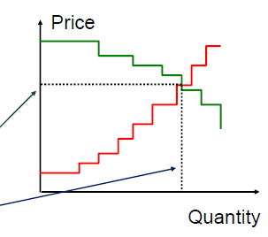
Centralized Auction
Producers enter their offers: quantity and price
Offers are stacked up to construct the supply curve
Consumers enter their bids: quantity and price
Bids are stacked up to construct the demand curve
Intersection determines the market equilibrium
Market clearing price
Transacted quantity

Slide 49
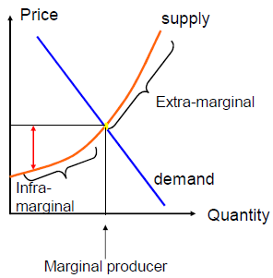
Centralized Auction
Everything is sold at the market clearing price
Price is set by the last unit sold
Marginal producer
Sells the last unit
Gets exactly its offered price
Still earns profit because offered price is greater than true cost
Infra-marginal producers
Get paid more than offered price
Collect economic profit
Extra-marginal producers
Sell nothing
Notes:
Marginal cost of an additional output unit is the cost of the additional input needed to produce that output

Slide 50
Bilateral Trades
Achieved through
Online Bulletin-boards
Brokers
Direct-search
Shopping around for portfolio optimization
Interaction for negotiation before sales
Direct or brokered deals result in price and quantity agreements known in advance
Equilibrium price is not defined centrally but is “discovered” through efficient market and remains confidential between parties
Agreed quantity is conveyed to system operator and is subject to transmission availability
Notes:
Marginal cost of an additional output unit is the cost of the additional input needed to produce that output

Slide 51
Reading ….
Chapter 2 in Kirschen and Strbac book
Notes:
Marginal cost of an additional output unit is the cost of the additional input needed to produce that output

Slide 52
Electricity Markets
How different market designs work?
Dr Kashif Imran
Adopted from lecture slides of Dr Ivana Kockar at University of Strathclyde

Slide 53
Reminder
Based on when the trading occurs there are
Forward/futures trading
Spot trading
Based on how trading quantities and prices are determined, there are
Centralized trading
Bilateral trading

Slide 54
Spot market for electricity
This is managed market run by the central system operator
Matches demand and supply
Determines a spot price
Provides ancillary services
Maintains security of the system

Slide 55
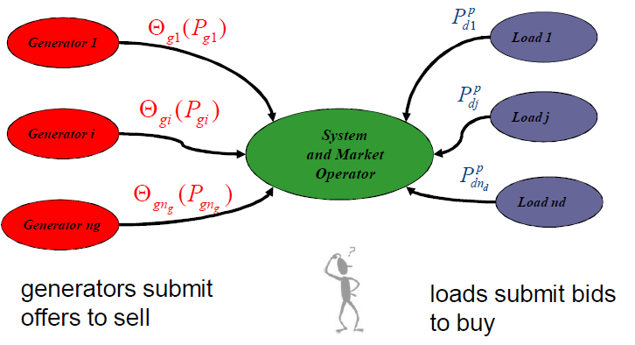
Spot market for electricity

Slide 56
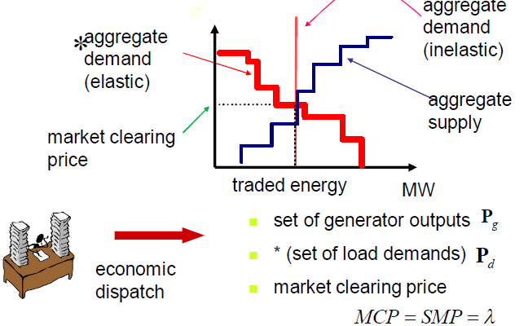
Market clearing – simple case

Slide 57
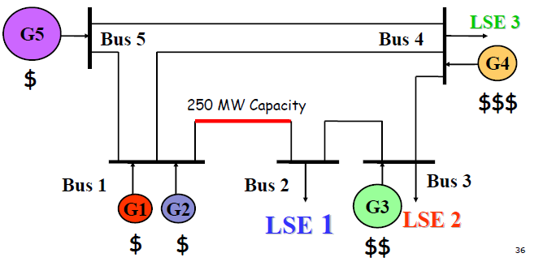
A Simple System Model
Notes:
Open access to Transmission (distribution) network is essential to ensure wholesale (retail) competition

Slide 58
Simple Market Clearing: behind the scenes
What is the goal of the market clearing
Determine generation output
Determine the price of electricity
What is considered
Generators offers
Including generators limits
Demand levels
Including demand elasticity and their bids
What is omitted
Network
Losses
Line constraints
Voltage limits and security
Notes:
Open access to Transmission (distribution) network is essential to ensure wholesale (retail) competition

Slide 59
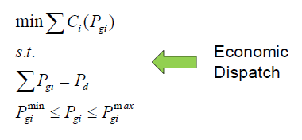
Market clearing “engine”
Power system analysis tool that looks how to distribute load among available generators in the most economic way
Notes:
Open access to Transmission (distribution) network is essential to ensure wholesale (retail) competition

Slide 60
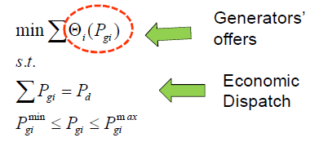
Market clearing “engine”
Generator could be linear, quadratic …. We retain the same shape of the function as for true costs
Notes:
Open access to Transmission (distribution) network is essential to ensure wholesale (retail) competition

Slide 61
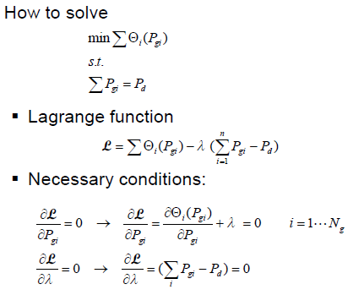
Economic Dispatch
Notes:
Open access to Transmission (distribution) network is essential to ensure wholesale (retail) competition

Slide 62
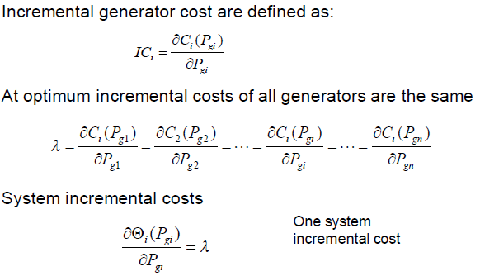
Economic Dispatch
Notes:
Open access to Transmission (distribution) network is essential to ensure wholesale (retail) competition

Slide 63
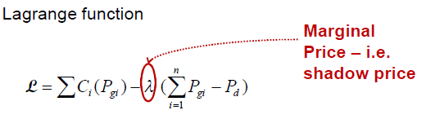
Meaning of Lagrange Multiplier
Notes:
Open access to Transmission (distribution) network is essential to ensure wholesale (retail) competition

Slide 64
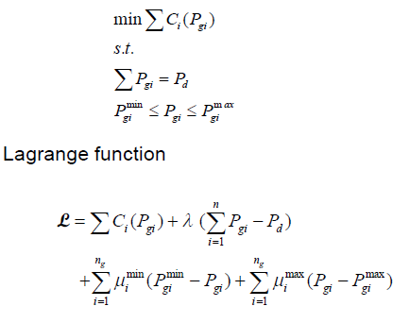
Economic Dispatch with generation limits
Notes:
Open access to Transmission (distribution) network is essential to ensure wholesale (retail) competition

Slide 65
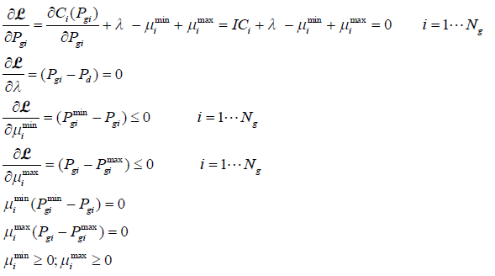
Optimality Conditions
Notes:
Open access to Transmission (distribution) network is essential to ensure wholesale (retail) competition

Slide 66
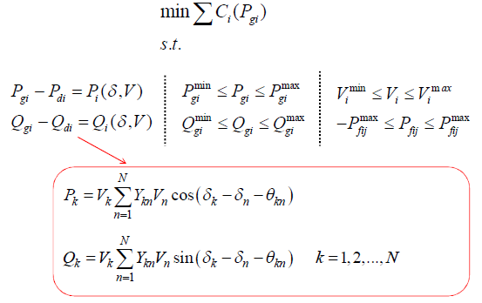
Optimal Power Flow - OPF
Notes:
Open access to Transmission (distribution) network is essential to ensure wholesale (retail) competition

Slide 67
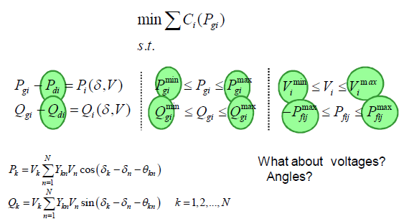
Optimal Power Flow (2)
What are the parameters
Notes:
Open access to Transmission (distribution) network is essential to ensure wholesale (retail) competition

Slide 68
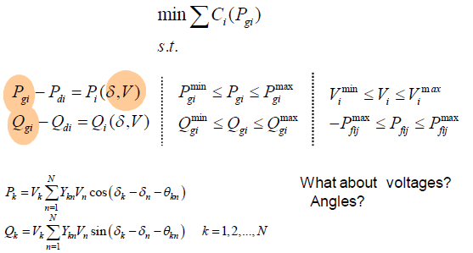
Optimal Power Flow (3)
What are the variables
Notes:
Open access to Transmission (distribution) network is essential to ensure wholesale (retail) competition

Slide 69
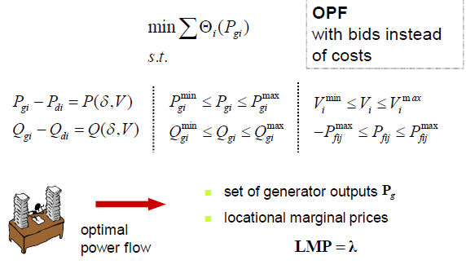
Market clearing – complex case

Slide 70
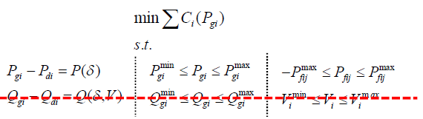
Market clearing – complex case
How to solve this optimization problem
Lagrange function
A bit of simplification
Infinite VAR sources V = 1 p.u.

Slide 71
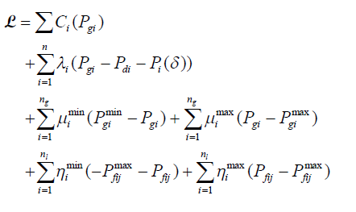
Lagrange function
Notes:
Open access to Transmission (distribution) network is essential to ensure wholesale (retail) competition

Slide 72
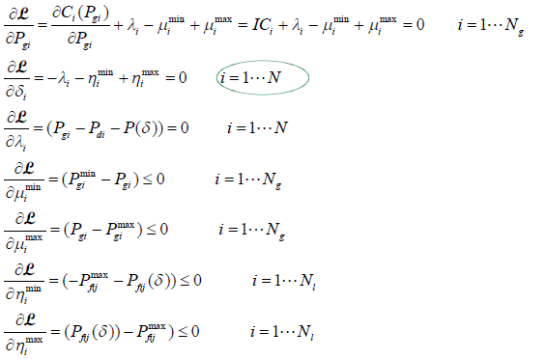
Optimality conditions
Notes:
Open access to Transmission (distribution) network is essential to ensure wholesale (retail) competition

Slide 73
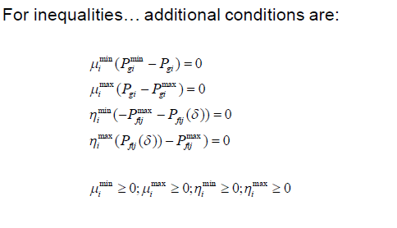
Optimality conditions
Notes:
Open access to Transmission (distribution) network is essential to ensure wholesale (retail) competition

Slide 74
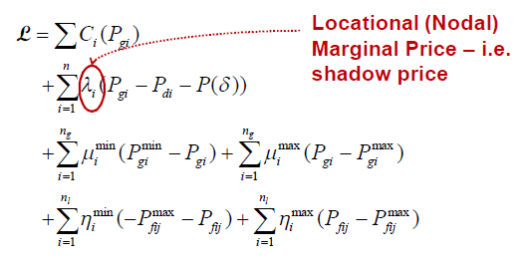
Lagrange Function
Notes:
Open access to Transmission (distribution) network is essential to ensure wholesale (retail) competition

Slide 75

Meaning of Lagrange Multiplier
Cost associated with maintaining each constraint
Multipliers associated with power balance equations tell us how much it costs to maintain power balance i.e. how much it will cost to increase demand at a given bus

Slide 76
Pricing Mechanisms
Marginal vs. Pay as Bid
Dr Kashif Imran
Adopted from lecture slides of Dr Ivana Kockar at University of Strathclyde

Slide 77
Pricing Mechanisms
An important component of electricity market design
Defines tariffs for electricity as well as for the various ancillary services
Central role in the market
As it sends monetary signals on the value of the resources
Sends signals that strongly influence future investments in the system infrastructure
The price of electricity must me competitive
A well designed pricing mechanism has to address
The problem of short term operation
Long-run efficient market operation
Market design, with its pricing schemes and rules, needs to tackle market imperfections
Market power by generators
Congestion of the transmission network

Slide 78
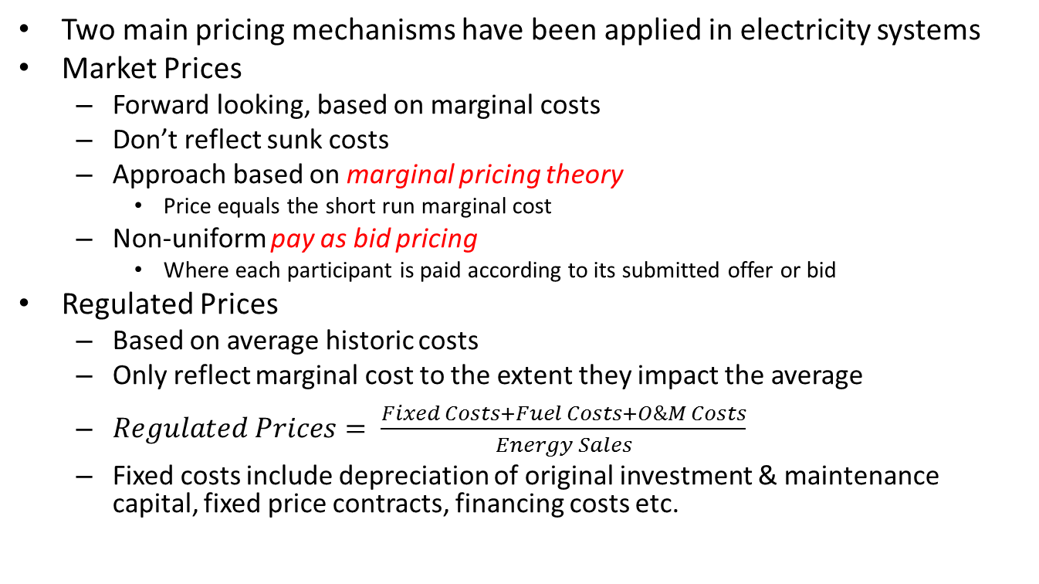
Pricing Mechanisms
Two main pricing mechanisms have been applied in electricity systems
Market Prices
Forward looking, based on marginal costs
Don’t reflect sunk costs
Approach based on marginal pricing theory
Price equals the short run marginal cost
Non-uniform pay as bid pricing
Where each participant is paid according to its submitted offer or bid
Regulated Prices
Based on average historic costs
Only reflect marginal cost to the extent they impact the average
$Regulated Prices= \frac{Fixed Costs+Fuel Costs+O\&M Costs}{Energy Sales}$
Fixed costs include depreciation of original investment & maintenance capital, fixed price contracts, financing costs etc.

Slide 79
Marginal Pricing
There are two main variations of marginal pricing
System marginal pricing
Locational marginal pricing

Slide 80
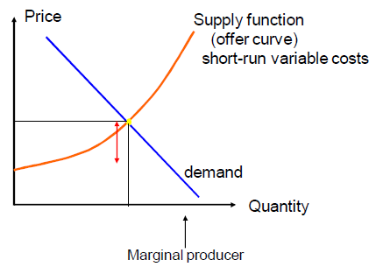
Marginal Pricing - SMP
The price is determined by a marginal generator

Slide 81
Marginal Pricing - SMP
Under System (Spot) Marginal Pricing
Generator offers are stacked in ascending merit order
Load bids are stacked in descending merit order
The clearing price is determined by the intersection of supply and demand curves
SMP is normally determined on hourly basis
SMP is uniformly applied to all generators, regardless of their location or offer price
Notes:
Open access to Transmission (distribution) network is essential to ensure wholesale (retail) competition

Slide 82
Marginal Pricing - SMP
SMP does not explicitly take into consideration transmission constraints
Various rules have been developed to manage transmission congestion problem
The initial version of England and Wales (E&W) pool market first calculated the merit order without considering transmission constraints
The dispatch was then revised under congested operation using heuristics
Redispatched generators were compensated by extra payments charged to customers on pro-rata basis
Norpool market of Scandanavian countries splits into zones, in case of congestion
Supply is provided by separate generator offers
Nordpool switches to a simplified Locational Marginal Pricing
Notes:
Open access to Transmission (distribution) network is essential to ensure wholesale (retail) competition

Slide 83
Marginal Pricing - SMP
Marginal Pricing method does not explicitly account for ancillary services
Separate charges devised to cover the costs of providing such services
Pro-rata charges - in the form of uplifts
Notes:
Open access to Transmission (distribution) network is essential to ensure wholesale (retail) competition

Slide 84
Marginal Pricing - LMP
Locational Marginal Pricing (LMP) is more complex.
The optimization is subject to various system constraints
Generation limits
Line capacities
Voltage limits
This dispatch also includes the supply of losses and other ancillary services necessary to support system operation
In practice, it may be tricky to compute because OPF is a difficult problem for large systems
Notes:
Open access to Transmission (distribution) network is essential to ensure wholesale (retail) competition

Slide 85
Pay-as-Bid Pricing
Non-uniform pricing
Each generator is paid according to its offer
No nodal or system price
How to allocate payments to customers
Pro-rata
Aumann-Shapley Approach
Notes:
Open access to Transmission (distribution) network is essential to ensure wholesale (retail) competition

Slide 86
Regulated Pricing
To be added ….
Notes:
Open access to Transmission (distribution) network is essential to ensure wholesale (retail) competition

Slide 87
Some Problems in Electricity Markets
Price Volatility
and
Transmission Congestion
Dr Kashif Imran
Adopted from lecture slides of Dr Ivana Kockar at University of Strathclyde

Slide 88
Price Volatility

Slide 89
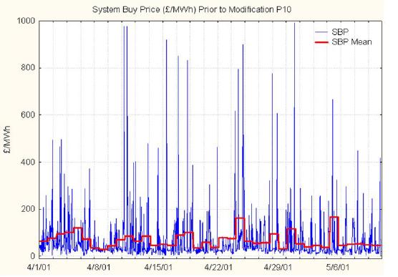
What is Price Volatility?

Slide 90
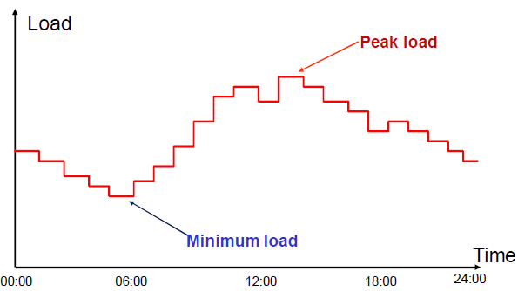
Why is the spot price for electricity so volatile?

Slide 91
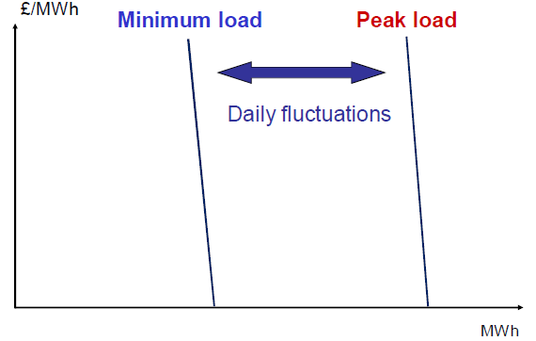
Demand Curves for Electricity

Slide 92

Supply Curve for Electricity

Slide 93

Supply and Demand for Electricity
Notes:
Open access to Transmission (distribution) network is essential to ensure wholesale (retail) competition

Slide 94

Supply and demand for electricity
Notes:
Open access to Transmission (distribution) network is essential to ensure wholesale (retail) competition

Slide 95

Supply and demand for electricity
Notes:
Open access to Transmission (distribution) network is essential to ensure wholesale (retail) competition

Slide 96
Transmission Congestion

Slide 97
Why do we care about congestion on transmission networks?
When congestion occurs, cost of energy increases
One or more transmission lines operate at full capacity
Energy from cheaper generators cannot be transmitted to loads
More expensive local generators may have to be dispatched
Transmission cost also goes up
Notes:
Open access to Transmission (distribution) network is essential to ensure wholesale (retail) competition

Slide 98

Uncongested Case
Notes:
Open access to Transmission (distribution) network is essential to ensure wholesale (retail) competition

Slide 99

Congested Case
Notes:
Open access to Transmission (distribution) network is essential to ensure wholesale (retail) competition

Slide 100
What are LMPs used for?
Locational Marginal Price
= energy component + loss component
+ market congestion component (MCC)
For Centralized Trades
Generators are paid this price for generated power
Loads pay this price for energy consumed, transmission losses incurred and network usage
In some markets, bilateral trades are charged locational price differences to cover network usage and losses
Notes:
Open access to Transmission (distribution) network is essential to ensure wholesale (retail) competition

Slide 101
Financial Transmission Rights (US)
What are they for?
Large differences of LMPs between two nodes can cause a problem in some types of electricity markets
Why?
Large payments for using a network, because it is based on nodal price differences
Relatively unpredictable
In these markets, there is a possibility to hedge against transmission payments
Buying a right to collect a revenue from transmission payments for a specified amount of power transfer between specified nodes of injection and withdrawal
These are called Financial Transmission Rights
Notes:
Open access to Transmission (distribution) network is essential to ensure wholesale (retail) competition

Slide 102

FTR Valuation Example
Perfect hedge as exposure to congestion charge is fully offset
Notes:
Open access to Transmission (distribution) network is essential to ensure wholesale (retail) competition

Slide 103
Other Transmission Rights/Pricing
Across a national border
Physical transmission rights on limited interconnector capacities between EU countries
Transmission is explicitly auctioned by coordinated effort of network operators on both sides
By comparison, within a country
Transmission is implicitly auctioned through energy market clearing by market operator based on transmission capability provided by network operator
Whereas, in PK
Discos bear Transfer Price as follows
Transfer Price = Capacity Transfer Charge + Energy Transfer Charge + Use of System Charges Fixed + Use of System Charges Variable + GST
Notes:
Open access to Transmission (distribution) network is essential to ensure wholesale (retail) competition

